Slide 1
IVUS: BASICS
PRESENTER: Dr. Monisha Dsouza

Slide 2
IVUS
Greyscale image: is derived amplitude of the reflected signal, not its radiofrequency.
White image: more of the signal reflected, greater amplitude
Black image: less of the signal reflected, lesser amplitude.

Slide 4
Mechanics of image formation in IVUS
Principle: Ultrasound waves reflect at interface of different acoustic impedance [tissue density].
US waves from the transducer are reflected at tissue interface; not reflected pass through the media: attentuated: absorption, scattering (small object size than wavelength)

Slide 5
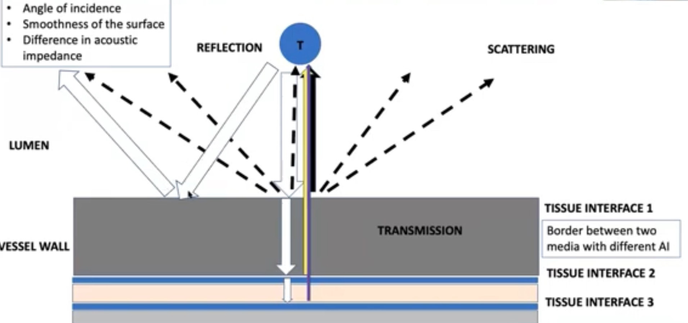

Slide 6
Coronary vessel wall anatomy
Three layers from inside to outside :-
Intima
Media : smooth muscle cells
Adventitia: multiple collagen fibers.
IVUS image in a normal coronary artery:
area of bright echo from the intima
area of dark zone due to the media
areas of multiple bright echoes from the adventitia

Slide 8
Intima, Media, and Adventitia
In normal arteries material that most strongly reflects ultrasound is collagen.
The reflectivity is 1000 times that of muscle.
The adventitia of coronary arteries has high collagen: echoreflective
Media has a low collagen (mostly muscular) :echolucent

Slide 9
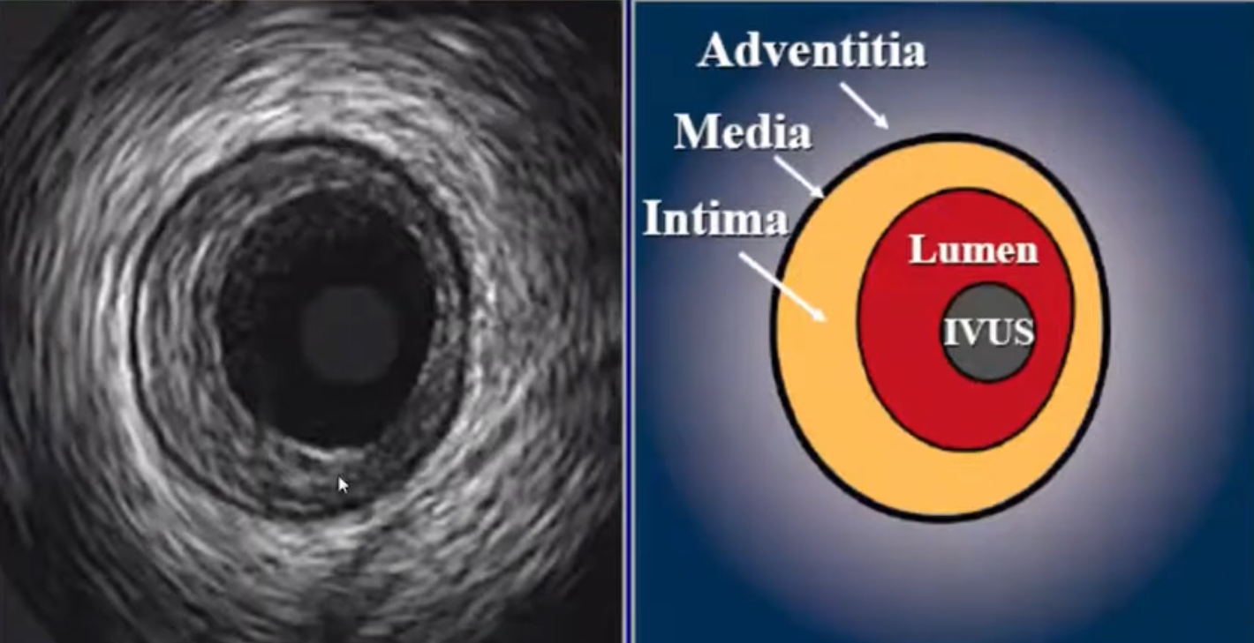

Slide 11
Resolution:
Ultrasound cannot reliably detect structures smaller than its resolution.
Resolution affects :
sharpness of an image,
the distinctness of the borders
reproducibility of the measurements.

Slide 12
Spatial Resolution
Ability to discriminate between small adjacent objects as distinct entities.
IVUS typical resolution :80 -100 microns axially ,200 -250 microns laterally.
Resolution increases as transducer frequency increases
Focusing the transducer improves resolution within the focused zone.

Slide 15
Contrast Resolution
Contrast resolution /dynamic range
Number of shades of grey that can be differentiated between the weakest and strongest targets
Low dynamic range :“black and black and white ” : they appear “contrasty ”
High dynamic range images: more shades of grey -can differentiate more tissue types and structural elements.

Slide 17
Near Field and Far Field
Near Field : IVUS beam fairly parallel for the distance; Image quality better.
Far Field: IVUS beam diverges
The length of near field: L = r2 / λ
L : length of the near field
r :radius (aperture) of the transducer
λ : wavelength

Slide 18
Penetration
Penetration depends on:
power output
Aperture
design of the transducer
imaging frequency
Penetration is inversely related to frequency

Slide 19
Blood Speckle
The intensity of the blood speckle increases exponentially with  the frequency of the transducer.
Higher frequency: greater resolution: smaller targets are well seen.
Stasis (because of red cell clumping or rouleaux rouleaux formation) - most evident when the catheter is across a tight stenosis.
Static blood can be more echodense than plaque.

Slide 20
Orientation
No absolute anterior, posterior, left and right orientation in IVUS images.
Position of lesions described with relation to hands of the clock relative to anatomical relations of the concerned coronary artery.
Perivascular landmarks: references for axial position and tomographic orientation within the vessel:
Pericardium
strands of muscle tissue
venous system
Side branches of the concerned artery.

Slide 25
IVUS types
There are two types of IVUS systems:
the mechanical system
the electronic system: multi-element array system: solid-state design IVUS system.
Both create an axial image covering 360 degrees of the vessel wall
Most coronary IVUS catheters can be passed through 5–6 French sheaths.

Slide 27
Mechanical systems
A single rotating transducer is driven by a flexible drive cable at 1,800 rpm (30 revolutions per second)
At approximately 1° increments, the transducer sends and receives ultrasound signals.
The time delay and amplitude of these pulses provide 256 individual radial scans for each image.
Mechanical transducer catheters requires flushing with saline to provide a fluid pathway for the ultrasound beam
Even small air bubbles can degrade image quality.

Slide 29
Electronic systems
Uses multiple phased array of small crystals positioned in a circumferential fashion.
Simultaneous transmission by one set of elements and receiving of reflected signals by a second set: synthetic aperture array
Real time imaging.
A central guidewire remains in the vessel: do not require rotation to acquire images nor do they need continuous flushing with saline.
Volcano Corporation (Rancho Cordova, CA) manufactures phased array catheters.

Slide 30
Transducer Selection
Larger transducers with lower frequencies are better for examination of large vessels
They create lower proximal image resolution, expanded imaging field, deeper near field, have greater penetration and resolution is not as critical
Smaller transducers with higher frequencies have higher proximal image resolution but a narrower imaging field: used for small vessels where resolution is more critical

Slide 31
Frequency and resolution
The frequency of an IVUS system determines its resolution.
Frequencies of 8 and 12 MHz are best suited for imaging large vessels (e.g. aorta, inferior vena cava)
Around 20 MHz for smaller vessels like the carotids and vessels of the lower extremity (e.g. femoropopliteal arteries)
Higher frequencies around 45 MHz for imaging of very small vessels (e.g. coronary arteries).

Slide 33
Procedure
1. An important prerequisite before inserting an IVUS catheter is to ensure that the patient is on therapeutic anticoagulation.
2. A high frequency IVUS catheter (40-60 MHz) has suitable image resolution in the coronary vasculature.
- Unless contraindicated, intracoronary nitroglycerine should be given before inserting the IVUS catheter to avoid coronary vasospasm.

Slide 34
3. Following standard PCI techniques, the selected coronary artery is engaged with a guide catheter and a guidewire is passed into the target artery.
4. Mechanical IVUS catheters require fastidious flushing of the sheath to remove any air to prevent air embolization and poor image quality
- multiple array catheters require flushing of the wire port prior to insertion in the body.

Slide 35
5. The IVUS catheter is then connected to the image console.
When the system is ready, it can be introduced into the target vessel through the guide over a guidewire under fluoroscopic guidance.
If resistance is met, it is important not to push the IVUS catheter but to remove, reassess and perform adequate steps such as vessel dilation prior to reinsertion

Slide 36
. 6. Once the IVUS catheter is at the desired location, imaging is performed by a slow pullback using a manual technique or by mechanical pullback sleds with rates of pullback of 0.5 or 1.0 mm/sec.
7. After imaging is complete, the catheter can be withdrawn, images reviewed and measurements made.

Slide 37
A final angiogram is performed after removing the IVUS catheter to ensure there was no injury to the artery.

Slide 38
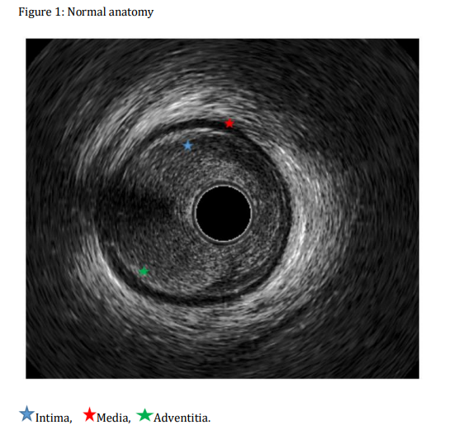
Interpretation of IVUS images
normal coronary artery

Slide 39
Atheroma morphology
Ultrasound images are fundamentally different from histology.
Soft (echolucent) plaques: The term “soft” refers not to the plaque’s structural characteristics, but rather to the acoustic signal that arises from low echogenicity.
High lipid content in a mostly cellular lesion.
Zone of reduced echogenicity could be :
necrotic zone within the plaque
an intramural hemorrhage
thrombus.
Most soft plaques contain minimal collagen and elastin

Slide 40
Fibrous plaques: These plaque have an intermediate echogenicity between soft (echolucent) atheromas and highly echogenic calcific plaques.
Fibrous plaques represent the majority of atherosclerotic lesions.
Greater the fibrous tissue content, the greater the echogenicity of the tissue.
Very dense fibrous plaques may produce sufficient attenuation or acoustic shadowing to be misclassified as calcified.

Slide 41
Mixed: Plaques frequently contain more than one acoustical subtype.
Appropriate terminology for these plaques includes a number of descriptions such as “fibrocalcific,” “fibrofatty,” .
Thrombus: An intraluminal mass, often with a layered, lobulated, or pedunculated appearance.
Thrombi may appear relatively echolucent or have a more variable gray scale with speckling or scintillation.
Blood flow in “microchannels” may also be apparent within some thrombi.
Stagnant blood flow can simulate a thrombus with accumulation of specular echoes within the vascular lumen.
Injection of contrast or saline may disperse the stagnant flow, clear the lumen, and allow differentiation of stasis from thrombosis.

Slide 43
Unstable lesions and ruptured plaque
Unstable coronary lesions are usually lipid-rich with a thin fibrous cap.
Hypoechoic plaques without a well-formed fibrous cap are presumed to represent potentially vulnerable atherosclerotic lesions.
Ruptured plaques : highly variable appearance.
Acute coronary syndrome: ulceration often with remnants of the ruptured fibrous cap
A variety of other appearances are common, including fissuring or erosion of the plaque surface.
The presence of thrombi may obscure IVUS detection of plaque fissuring or ulceration.

Slide 45
Plaque ulceration: A recess in the plaque beginning at the luminal-intimal border, typically without enlargement of the EEM compared with the reference segment.
Plaque rupture: A plaque ulceration with a tear detected in a fibrous cap. Contrast injections may be used to prove and define the communication point

Slide 47
Aneurysms, pseudoaneurysms, true vs. false lumen
True aneurysm: A lesion that includes all layers of the vessel wall with an EEM and lumen area >50% larger than the proximal reference segment.
Pseudoaneurysm: Disruption of the EEM, usually observed after intervention.
True versus false lumen: A true lumen is surrounded by all three layers of the vessel-intima, media, and adventitia.
Side branches communicate with the true, but not with the false lumen.
A false lumen is a channel, usually parallel to the true lumen, that does not communicate with the true lumen over a portion of its length

Slide 48
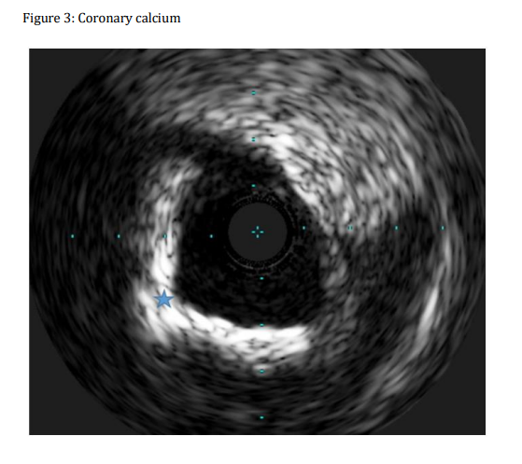

Slide 49
IVUS measurements: Qualitative
IVUS is a reliable tool in identification of various coronary pathologies including thrombus, intimal hyperplasia, soft plaques, fibrous plaques and coronary calcifications.
These characteristics are demarcated by differences in echogenicity:
-soft plaques
-fibrous plaques
-calcific lesions
[low, intermediate and high echogenicity on IVUS imaging]

Slide 53
IVUS measurements: Quantitative
The leading edge of the image boundaries is used to perform all IVUS measurements, not the trailing edge.
Lumen measurements are performed using the interface between the lumen and the leading edge of the intima.

Slide 54
Definition of “reference” segment
Proximal reference: The site with the largest lumen proximal to a stenosis but within the same segment (usually within 10 mm of the stenosis with no major intervening branches).
This may not be the site with the least plaque.
Distal reference: The site with the largest lumen distal to a stenosis but within the same segment (usually within 10 mm of the stenosis with no intervening branches).
This may not be the site with the least plaque.
Largest reference: The largest of either the proximal or distal reference sites.
Average reference lumen size: The average value of lumen size at the proximal and distal reference sites.

Slide 56
Definition of “lesion”
Lesion: A lesion represents accumulation of atherosclerotic plaque compared with a predefined reference.
Stenosis: A stenosis is a lesion that compromises the lumen by at least 50% by cross-sectional area (CSA) (compared with a predefined reference segment lumen).
Worst stenosis (T-1): The stenosis with the smallest lumen size.
Secondary stenoses (T-2, T-3, etc.): Lesions meeting the definition of a stenosis, but with lumen sizes larger than the worst stenosis.

Slide 57
Other commonly used measurements include:
(i) lumen cross sectional area (CSA) which is the area bounded by the luminal border
(ii) minimum and maximum lumen diameters which are the shortest and longest diameters through the center point of the lumen respectively
(iii) lumen area stenosis which is reference lumen CSA minus minimum lumen CSA

Slide 58
Border measurements
In muscular arteries such as the coronary arteries, there are frequently three layers:
The innermost layer consists of a complex of three elements: intima, atheroma (in diseased arteries), and internal elastic membrane.
This innermost layer is relatively echogenic compared with the lumen and media.
The trailing edge of the intima (which would correspond to the internal elastic membrane) cannot always be distinguished clearly.

Slide 59
Second layer is the media: less echogenic than the intima.
The third and outer layer consists of the adventitia and periadventitial tissues.
- There is no distinct boundary on IVUS images separating the true adventitia from surrounding perivascular tissues.

Slide 60
Lumen measurements
Measurements are relative to the center of the lumen, not center of the IVUS catheter.
Lumen CSA: The area bounded by the luminal border.
Minimum lumen diameter: The shortest diameter through the center point of the lumen.
Maximum lumen diameter: The longest diameter through the center point of the lumen.
Lumen area stenosis: (Reference lumen CSA minus minimum lumen CSA)/reference lumen CSA.
The reference segment used should be specified (proximal, distal, largest, or average—see above).

Slide 61
EEM measurements
A discrete interface at the border between the media and the adventitia corresponds to the location of the EEM.
The recommended term for this measurement is EEM CSA, rather than alternative terms such as “vessel area” or “total vessel area.”

Slide 62
Atheroma measurements
Plaque plus media (or atheroma) CSA: The EEM CSA minus the lumen CSA.
Maximum plaque plus media (or atheroma) thickness: The largest distance from the intimal leading edge to the EEM along any line passing through the center of the lumen.
Minimum plaque plus media (or atheroma) thickness: The shortest distance from intimal leading edge to the EEM along any line passing through the luminal center of mass.
Plaque (or atheroma) burden: Plaque plus media CSA divided by the EEM CSA.

Slide 64
Calcium measurements
Calcific deposits appear as bright echoes that obstruct the penetration of ultrasound, a phenomenon known as “acoustic shadowing.”
Calcium deposits are described qualitatively according to their location (e.g., lesion vs. reference) and distribution:
Superficial: The leading edge of the acoustic shadowing appears within the most shallow 50% of the plaque plus media thickness.
Deep:The leading edge of the acoustic shadowing appears within the deepest 50% of the plaque plus media thickness.
The arc of calcium can be measured (in degrees) by using an electronic protractor centered on the lumen.
Semi-quantitative grading has also been described, which classifies calcium as absent or subtending 1, 2, 3, or 4 quadrants.
The length of the calcific deposit can be measured using motorized transducer pullback

Slide 65
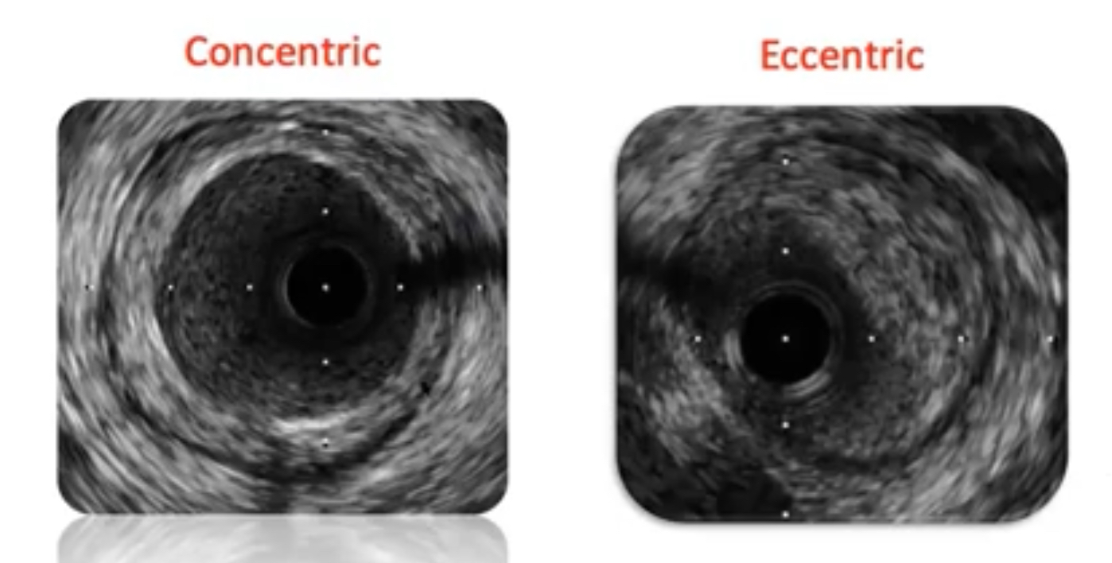

Slide 67
Recommendations for use of IVUS for PCI
CLASS IIa:
-IVUS is a reasonable option to assess angiographically indeterminant left main CAD (Level of Evidence: B)
-IVUS and coronary angiography are within reason 4 to 6 weeks and 1-year post cardiac transplantation to rule out donor CAD, detect rapidly progressive cardiac allograft vasculopathy, and provide prognostic information (Level of Evidence: B)
-IVUS is a reasonable option to determine the mechanism of stent restenosis (Level of Evidence: C)

Slide 68
CLASS IIb:
IVUS may be reasonable in assessing non–left main coronary arteries possessing angiographically intermediate coronary stenoses (i.e., 50% to 70% diameter stenosis) (Level of Evidence: B)
IVUS may be considered for the guidance of coronary stent implantation, especially in cases of left main coronary artery (LMCA) stenting (Level of Evidence: B)
IVUS may be reasonable for the determination of the mechanism of stent thrombosis (Level of Evidence: C)

Slide 69
CLASS III:
IVUS for routine lesion assessment is not a recommendation if revascularization with PCI or CABG is not being contemplated (Level of Evidence: C)

Slide 70
Uses of IVUS: left main coronary artery stenoses
A minimal lumen diameter of <2.8 mm or a minimal lumen area of <6 mm² suggests a physiologically significant lesion for which patients may benefit from revascularization.
A minimal lumen area >7.5 mm² suggests that revascularization may be safely deferred.
A minimal lumen area between 6 and 7.5 mm² requires further physiological assessment, such as measurement of FFR.

Slide 71
Uses of IVUS: non–left main stenoses
Minimal lumen diameter >2.0 mm and minimal lumen area >4.0 mm² correlate with low event rates.
However, in smaller-diameter arteries (minimal lumen area <3.0 mm²), measurement of FFR may more accurately reflect a significant stenosis.
Studies correlating IVUS measures with ischemia have not specified the size of coronary arteries for which correlations are valid.

Slide 73
Post-cardiac transplantation surveillance of CAD
IVUS evaluation of the coronary vasculature 4 to 6 weeks and 1 year after cardiac transplantation can be used to identify:
donor CAD
demonstrate rapidly progressive cardiac allograft vasculopathy
prognostic information: superior to angiography in the early detection of the diffuse, immune-mediated, cardiac allograft vasculopathy

Slide 75
Uses of IVUS: in-stent restenosis, stent thrombosis
Used to identify stent underexpansion or malapposition (struts not touching the lumen interface and “free floating” in the lumen) : associated with thrombosis
To evaluate the mechanical causes of stent failure: degree of neointimal hyperplasia in ISR

Slide 77
IVUS for CTO interventions
IVUS can help direct crossing total occlusions by showing the location of the wire in plaque, media/adventitia, or extravascular locations.
IVUS can be used for identification of the precise site of occlusion for stumpless lesions, antegrade and retrograde tracking of the guidewire, CART or reverse CART techniques, and optimal balloon sizing and dilatation.
IVUS substantially decreases the use of contrast and radiation exposure.
The major limitation is the presence of calcium that impairs the detection of the true lumen.

Slide 78
Advantages over angiogram

Slide 80
IVUS artifacts

Slide 81
Non-uniform rotational distortion (NURD)
This artifact may be seen with mechanical systems secondary to mechanical binding of the drive cable that rotates the transducer.
This can be due to multiple reasons including:
vessel tortuosity
tortuous shapes/ kinking/too small a lumen of guide catheters
kinking of the imaging sheath
changes in position between diastole and systole
variance in manufacturing of the hub or driveshaft
excessive tightening of a hemostatic valve
Artifacts can also occur when a wire channel lies adjacent to the transducers.

Slide 83
Motion artifacts:
A distinct motion artifact can result from non-stable catheter position.
Occasionally, the vessel moves before a complete circumferential image can be created.
This results in cyclic deformation of the image.
Both mechanical and solid state transducers can move as much as 5 mm between diastole and systole.

Slide 84
Near field artifacts:
These include:
ring down artifacts
blood speckle artifacts:

Slide 85
Ring-down artifacts
Bright halos around the guiding catheter.
Occur from high amplitude ultrasound signals from the transducer.
They are produced by acoustic oscillations in the transducer, which result in high-amplitude ultrasound signals that obscure the area immediately adjacent to the catheter.
Time gain compensation (TGC) and digital subtraction of a reference mask can be used to reduce this artifact.

Slide 86
Blood speckle artifacts
Occur with increasing transducer frequency and decreasing blood flow velocity, thereby limiting the ability to distinguish lumen from tissue especially soft plaque, neointima, and thrombus).
This problem is exacerbated by flow stagnation or rouleaux formation, often most evident when the catheter is across a tight stenosis or within certain dissections (e.g., intramural hematomas).
Flushing contrast or saline to clear the lumen of the guiding catheter can help identify tissue borders.
TGC manipulation and computer based imaging algorithms can be applied to decrease blood speckle.

Slide 88
Side lobe artifacts:
Seen as bright round lines that occur adjacent to a hyperechoic structure.
They occur when low-energy sound beams are reflected outside the central beam and are erroneously assigned to the main beam parallel to the false location.

Slide 89
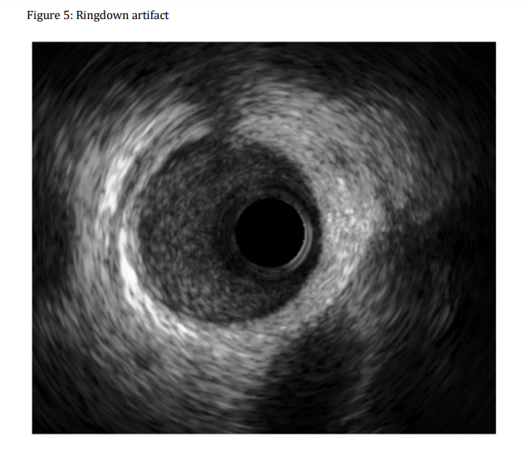
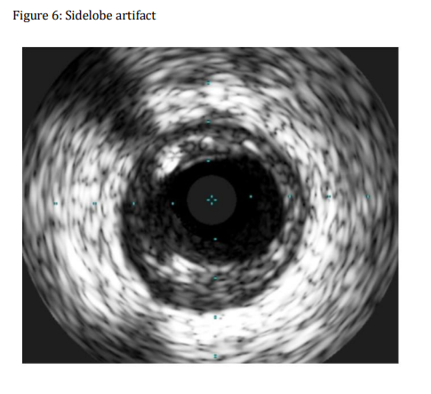

Slide 90
Obliquity, eccentricity, and problems of vessel curvature
Current imaging techniques assume that the vessel is circular, the catheter is located in the center of the artery, and the transducer is parallel to the long axis of the vessel.
Transducer obliquity and vessel curvature : false impression that the vessel is elliptical: overestimation of dimensions and a reduction in image quality .
Lower image quality and errors in interpretation are more likely when the IVUS catheter is not parallel to the vessel wall.

Slide 91
Advances

Slide 92
Virtual histology IVUS (VH-IVUS)
IVUS-based-post-processing modality that can create colorcoded images of the coronary plaque and vessel lumen.
Plaque is classified as
(i) White: dense calcium
(ii) Dark green: fibrous tissue
(iii) Light green: fibrofatty plaque
(iv) Red: necrotic core.

Slide 94
The imaging technique is similar to gray-scale IVUS with a gradual pull back of the catheter after administration of intracoronary nitroglycerine.
VHIVUS can identify high-risk plaques even among non-culprit lesions :identify dynamic changes in plaque morphology.

Slide 98
Contraindications
No true absolute contraindications for IVUS
Extreme vessel tortuosity and angulation that would preclude the ability to deliver an IVUS catheter to the area of interest is a relative contraindication.
An indirect IVUS contraindication would be a patient who is:
-not a suitable candidate for systemic anticoagulation
-not a candidate for angiography and cardiac catheterization in general.

